Slide 1


Welcome to
Rossendale Borough Council’s
Development Control Committee
Date 23rd June 2026

Slide 2
Item B1
2026/0142 – Land Off, Fieldfare Way, Bacup, Lancashire
S.73 Application: variation of Condition 2 (approved plans) pursuant to planning appeal decision APP/B2355/W/24/3356090, to enable house type alterations to plots 39, 41, 46, 48, 49, 50, 51, 52 and 55.

Slide 3
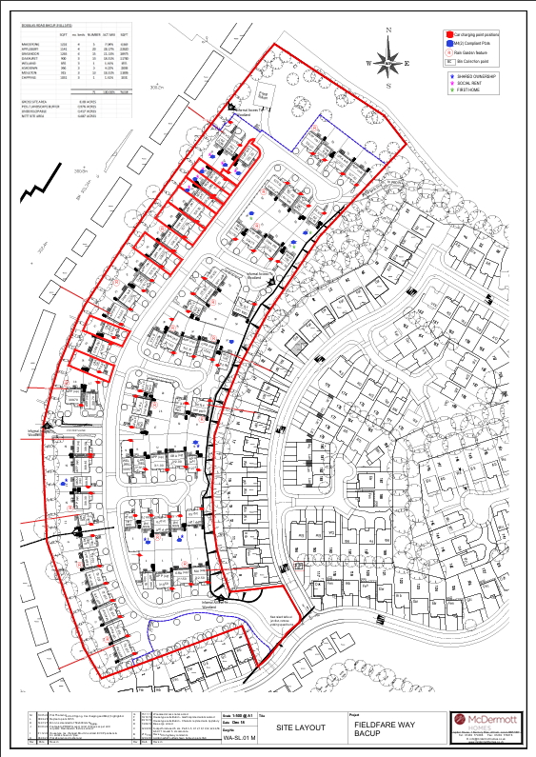
Site Layout

Slide 4
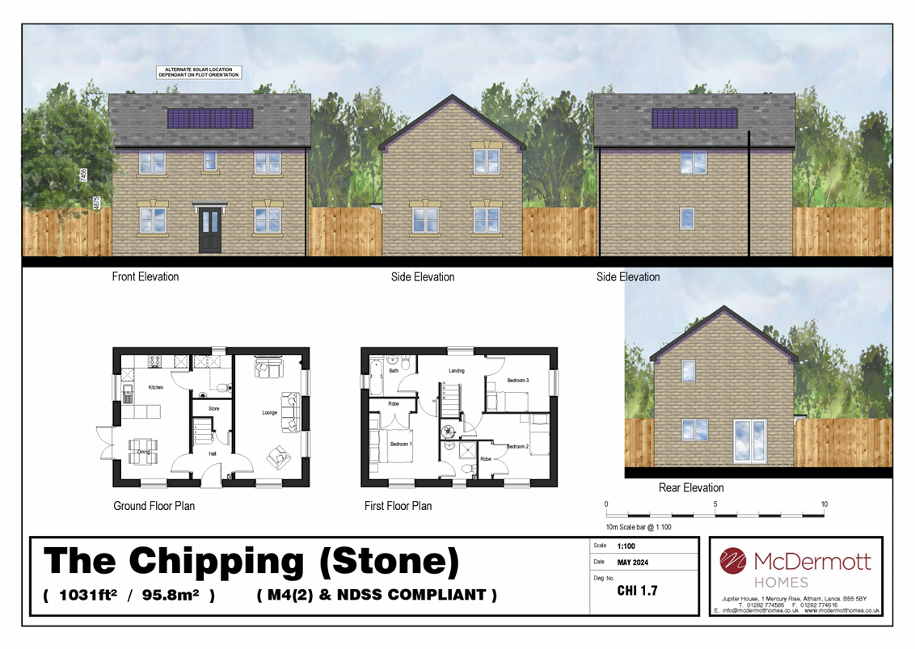
Elevations & Floor Plans

Slide 5
Item B2
2022/0577 – Alderwood, Market Street, Edenfield, Bury, Lancashire, BL0 0JH
Full: Development of 3 No Detached properties and all associated works

Slide 6
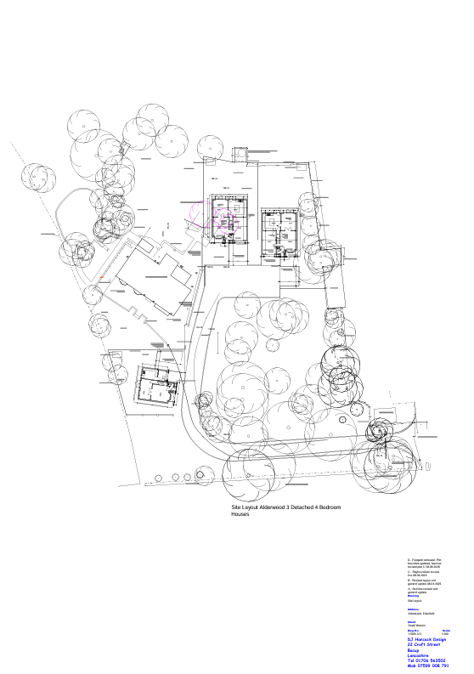
Site Layout

Slide 7
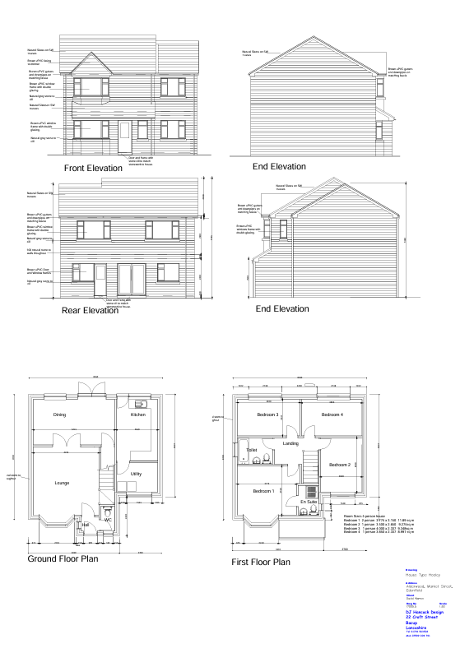
House Type Healey

Slide 8
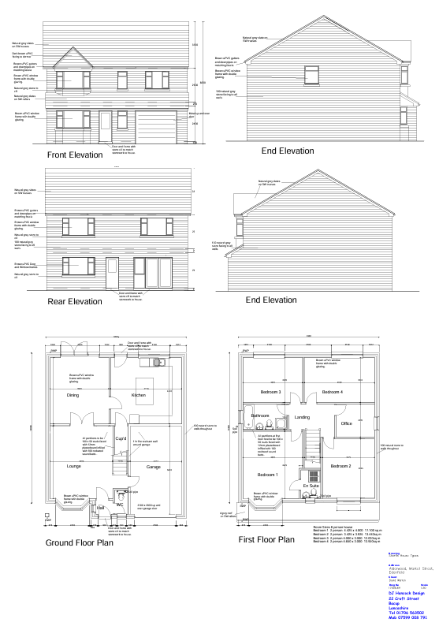
House Type Sherfin

Slide 9
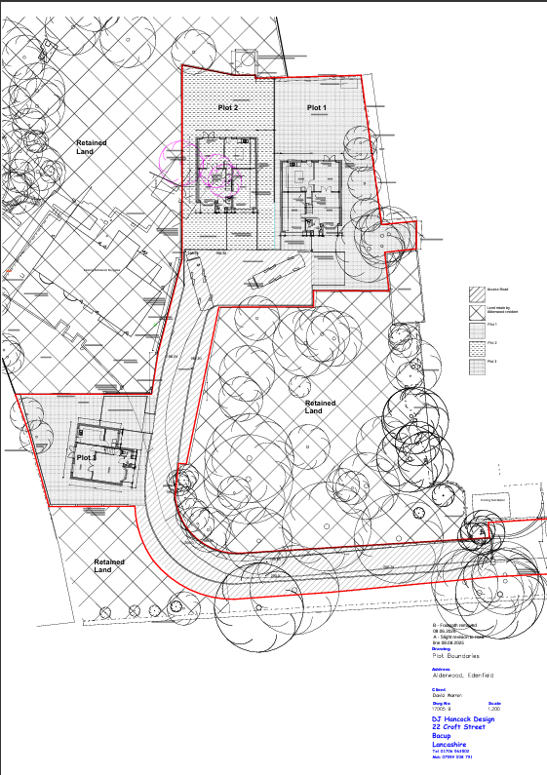
Plot Boundaries

Slide 10
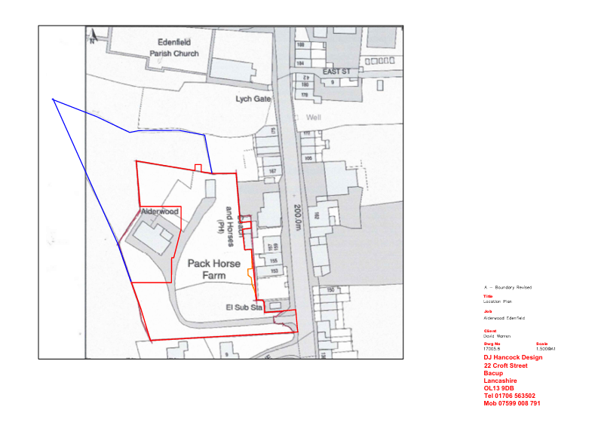
Location Plan

Slide 11
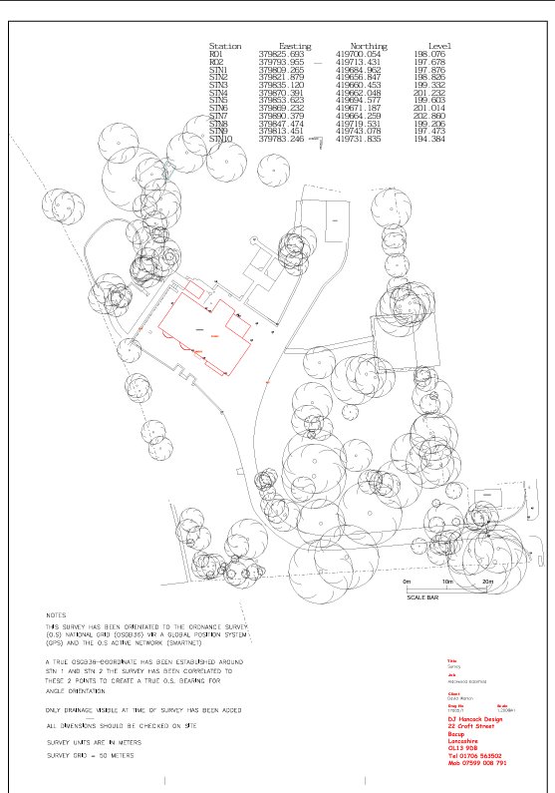
Survey

Slide 12
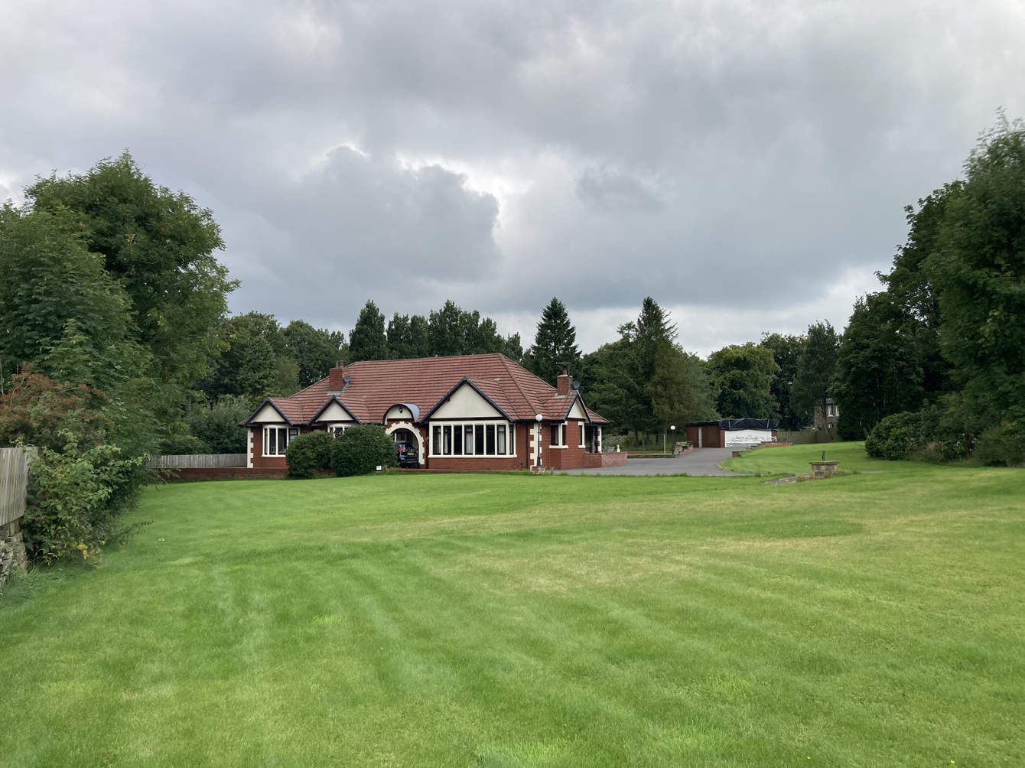
Photograph

Slide 13
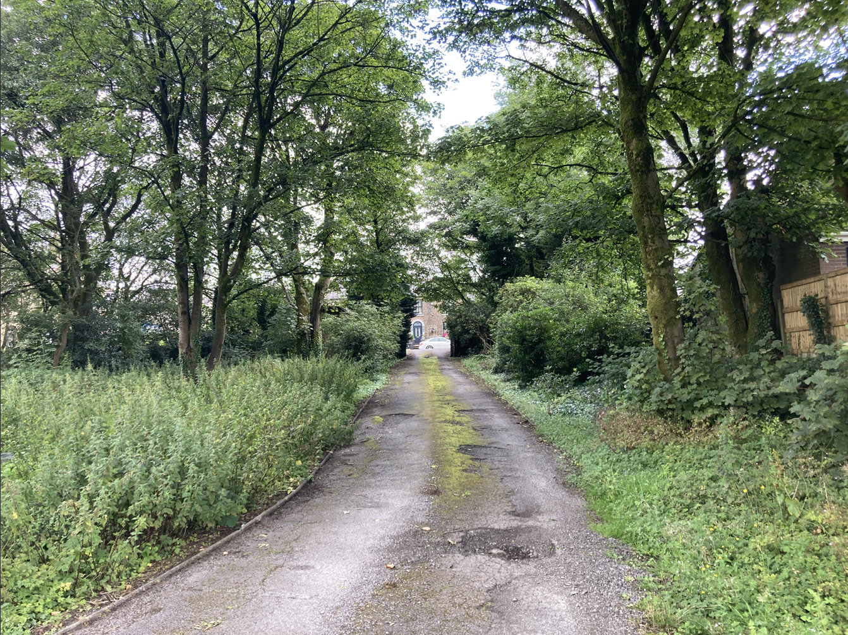
Photograph

Slide 14
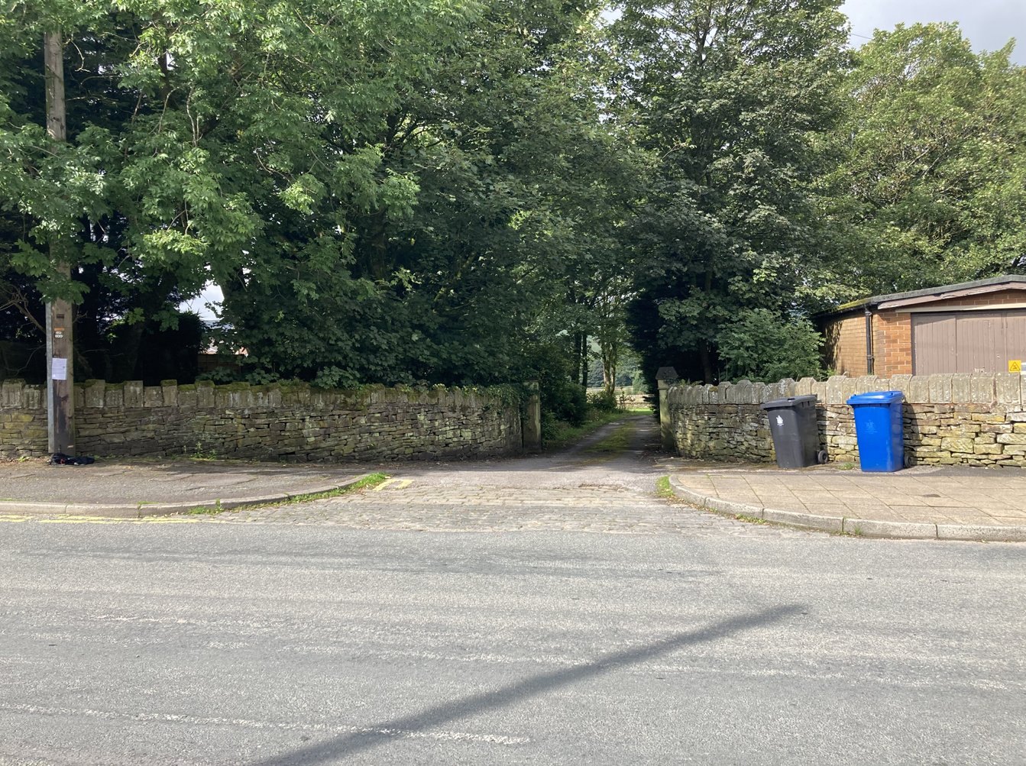
Photograph

Slide 15
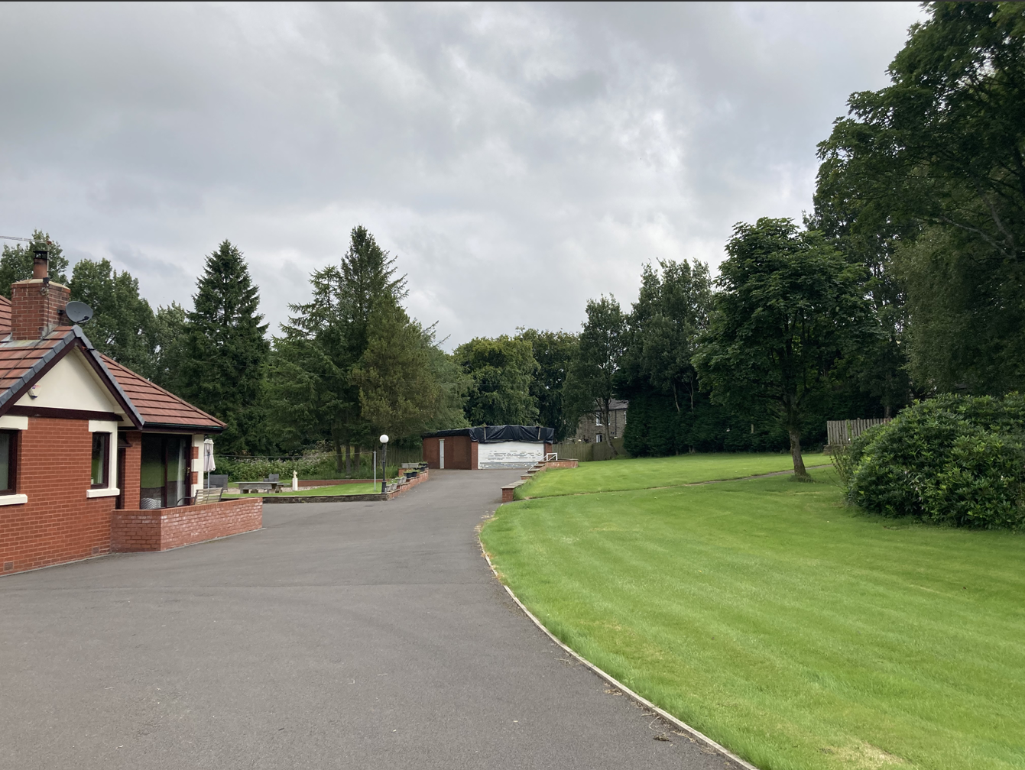
Photograph

Slide 16
Item B3
2025/0136 – 65 Helmshore Road, Haslingden, Rossendale, Lancashire, BB4 4BW
Proposed demolition of a section of the existing dwelling to facilitate vehicular access, conversion of remainder of house into 3x apartments and construction of proposed 4x Bungalows to rear of site.

Slide 17
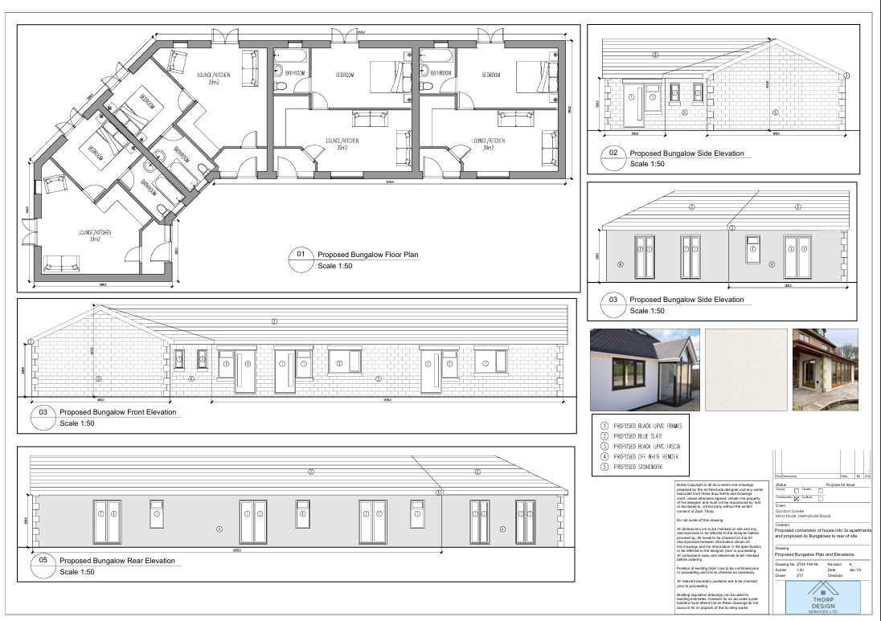
Proposed Bungalow Plan and Elevations

Slide 18
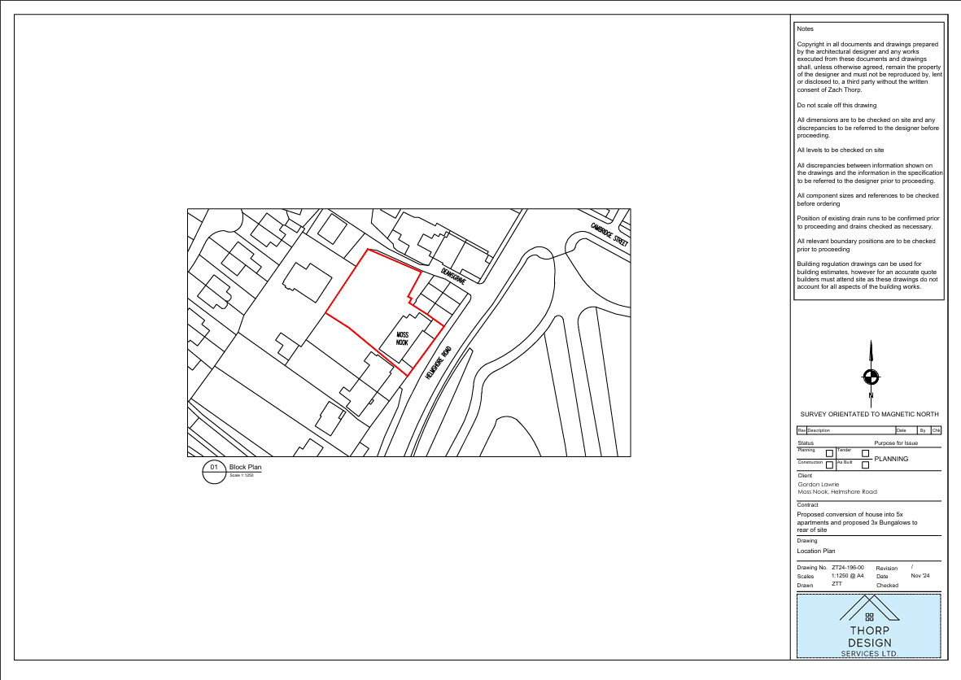
Location Plan

Slide 19
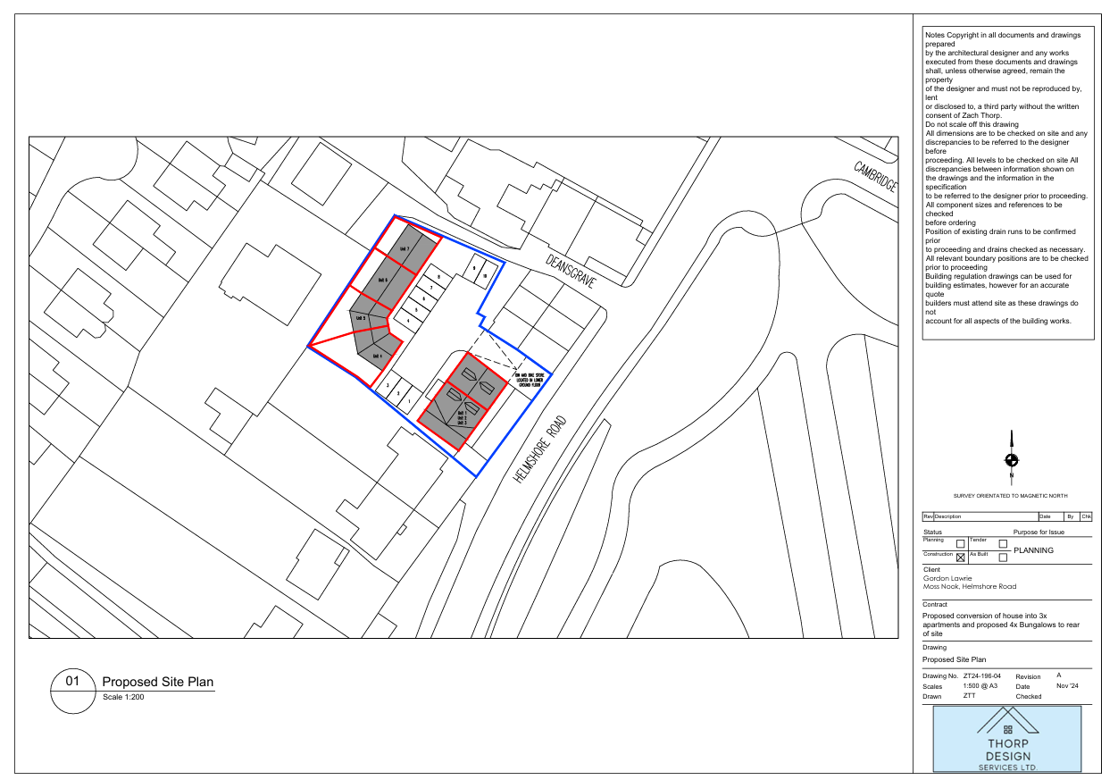
Proposed Site Plan

Slide 20
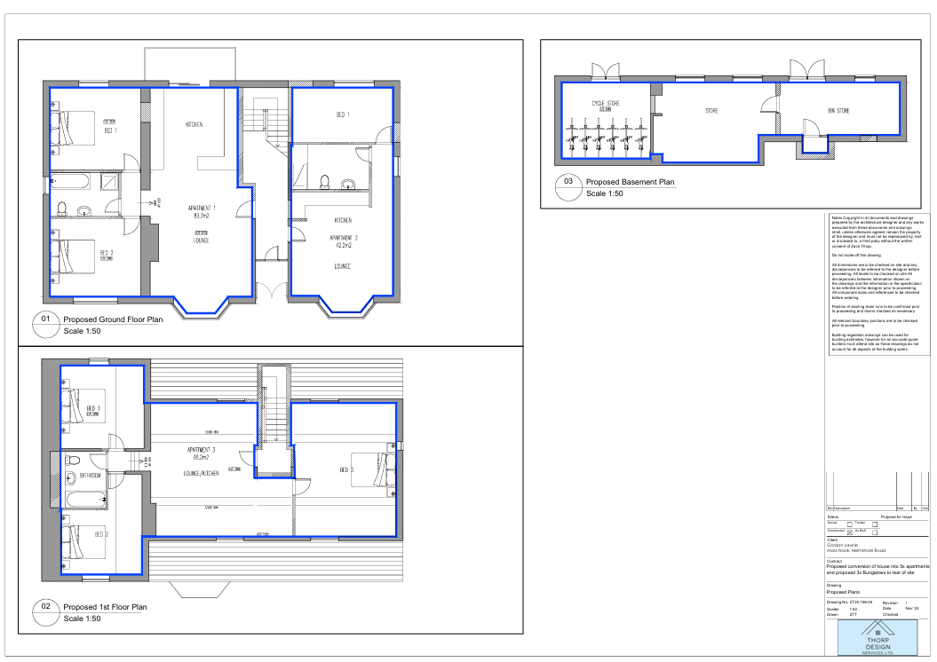
Proposed Plans

Slide 21
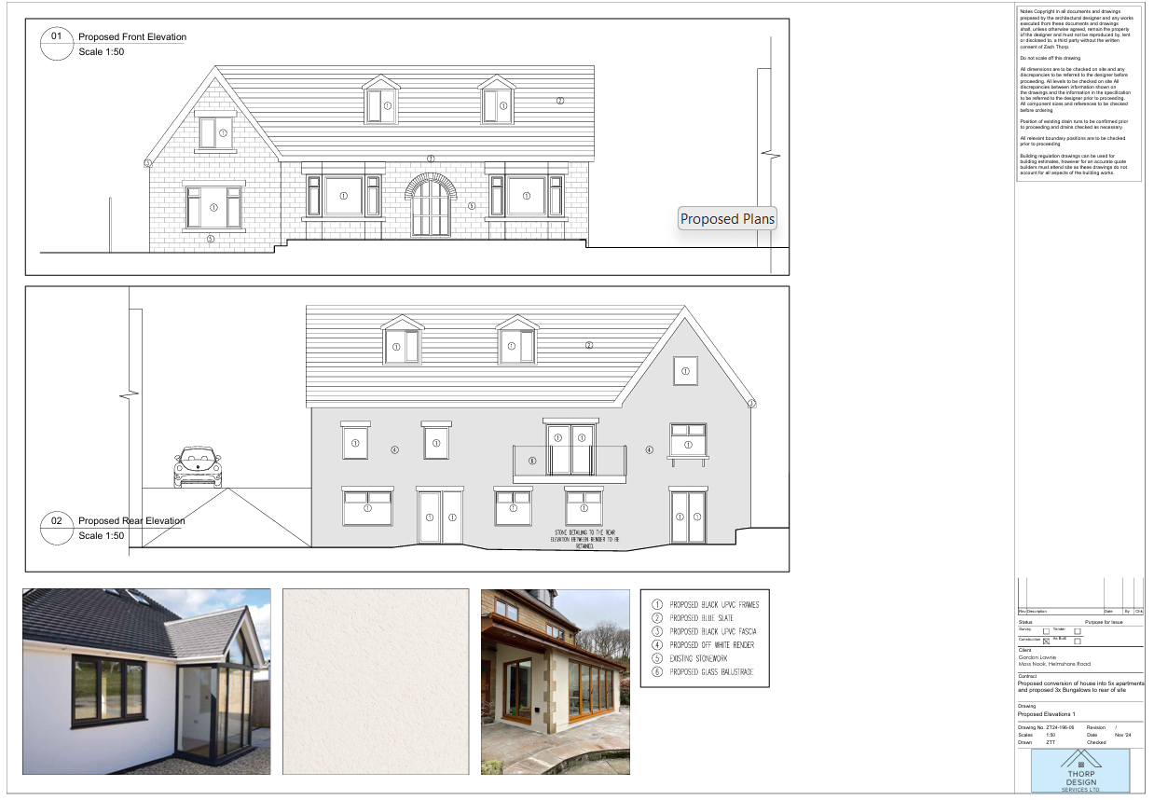
Proposed Elevations 1

Slide 22
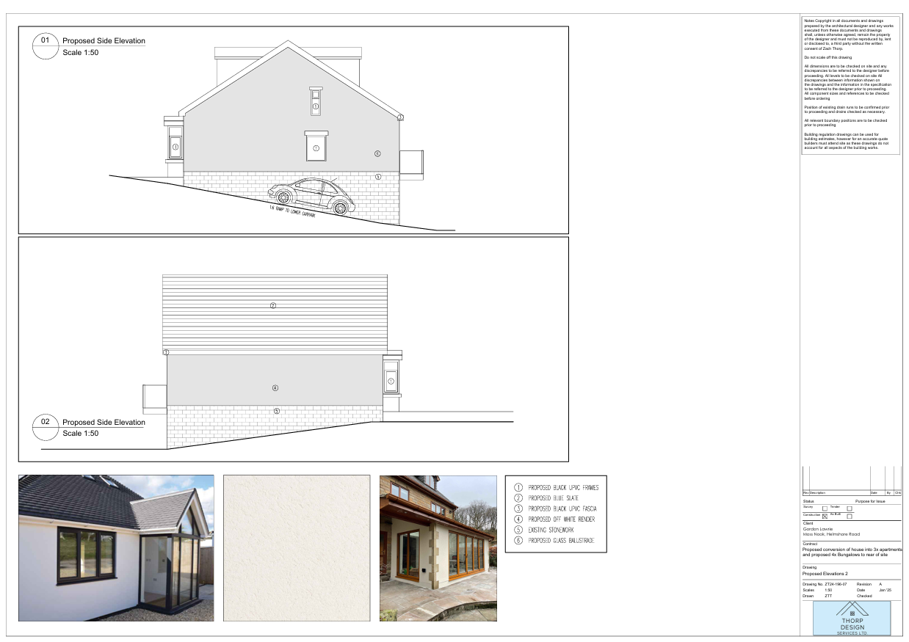
Proposed Elevations 2

Slide 23
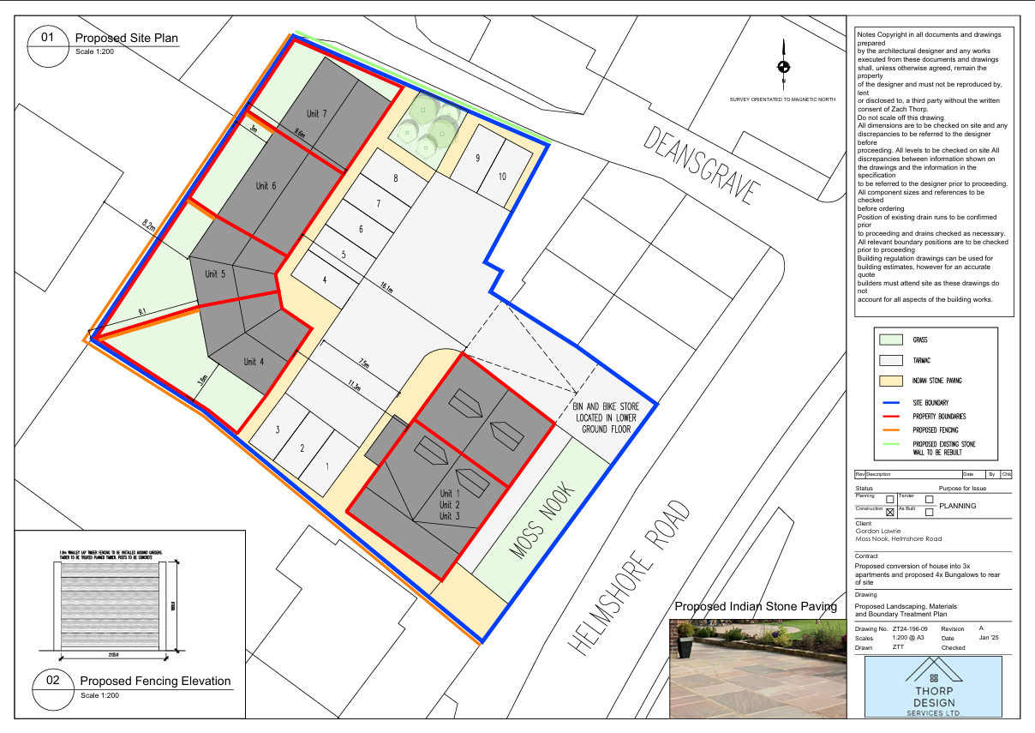
Proposed Landscaping, Materials and Boundary Treatment Plan

Slide 24
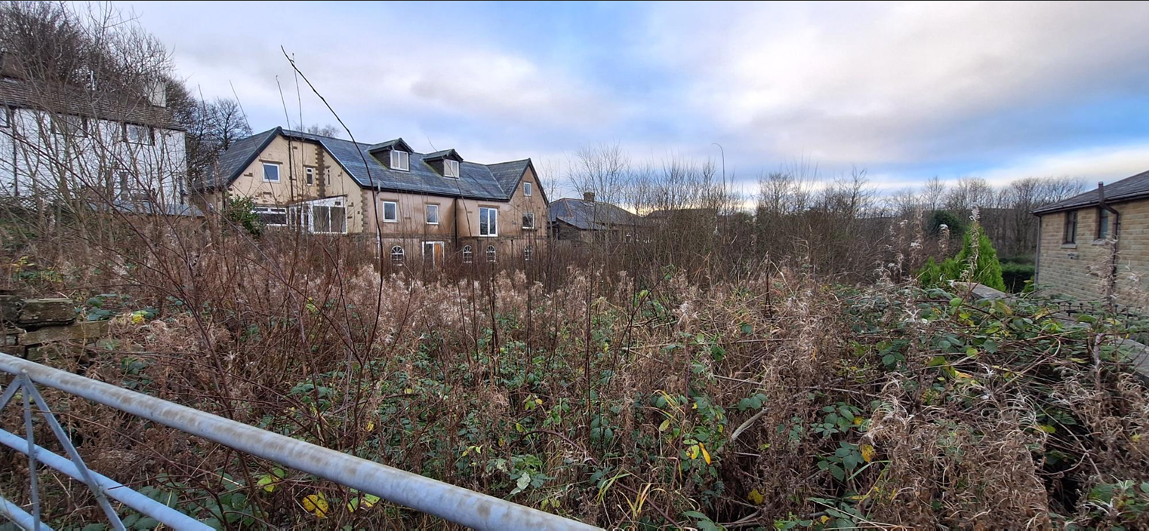
Photographs

Slide 25
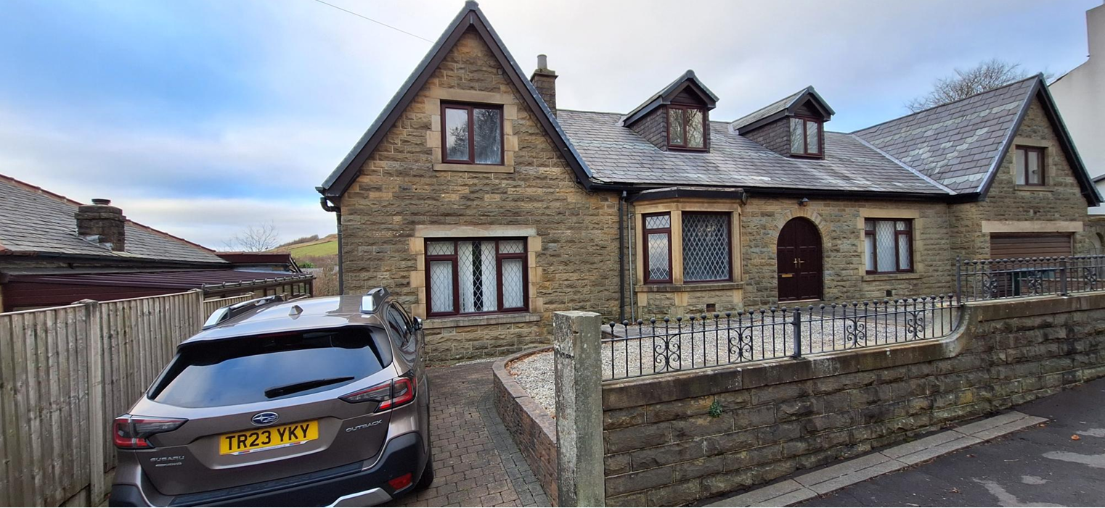
Photographs

